Slide 1

A Project on
Fingerprint-Based Blood Group Detection Using Deep Learning and Image Processing
Submitted by
PARASURAM T 512221205012
PARASURAMAN K 512221202013
GUIDE
Dr. V. RAJI, M.E., Ph.D.,
Department of Information Technology
Notes:
1

Slide 2
Abstract
1
Blood group prediction is crucial for medical diagnostics and emergency care.
2
Traditional methods require blood samples, lab equipment, and time-consuming procedures, making them impractical in urgent situations.
3
This study explores a non-invasive approach using fingerprint images and deep learning (CNNs) to detect blood groups.
Faster and more efficient than conventional methods.
Reduces dependency on laboratory facilities.
Enhances accessibility for real-world medical applications.
Extensive experimentation validates the feasibility of this technique for practical use in healthcare.
Notes:
2

Slide 3
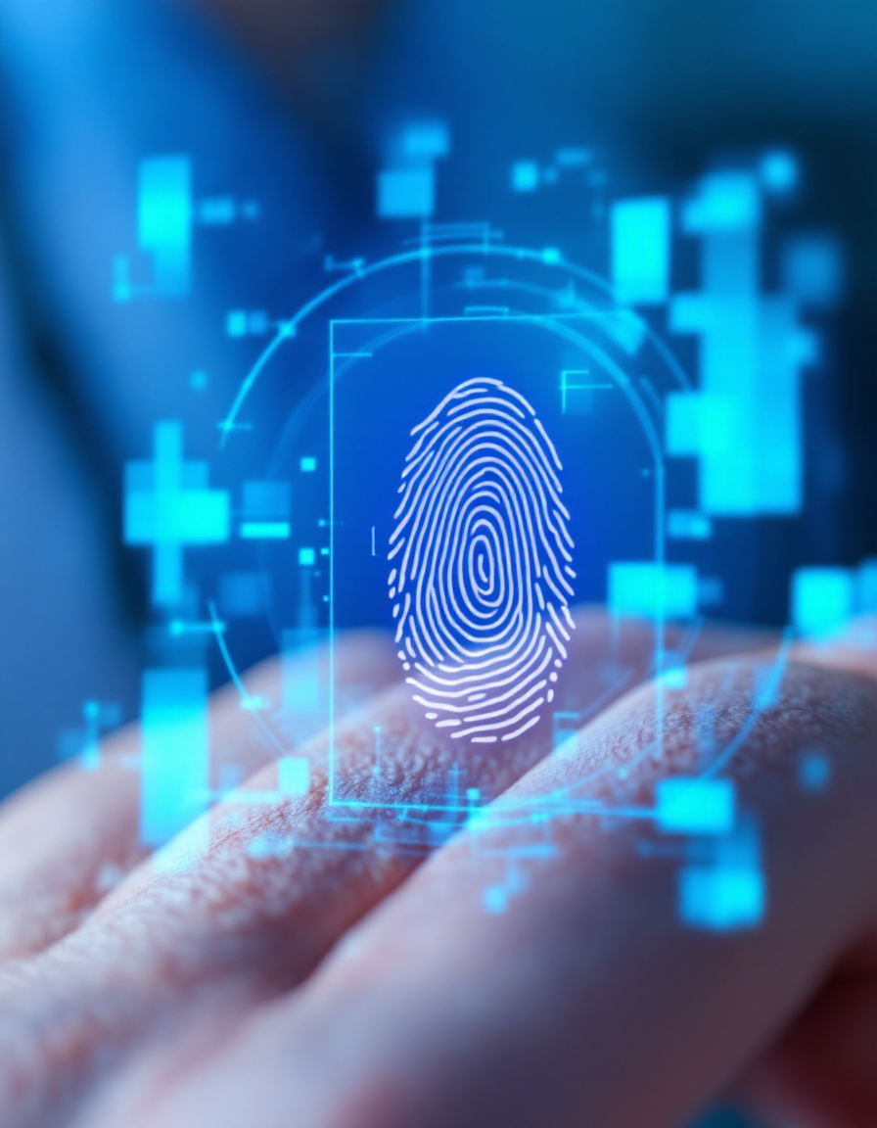
Introduction
Traditional blood group detection relies on serological tests, which are invasive, time-consuming, and require laboratory facilities.
The increasing demand for non-invasive, cost-effective, and rapid diagnostic methods has led to exploring fingerprint-based blood group detection.
Deep learning and image processing techniques can analyze fingerprint patterns to predict blood groups with high accuracy.
Our study proposes a CNN-based approach to classify blood groups using fingerprint images, improving accessibility and efficiency in healthcare settings.
Notes:
1

Slide 4
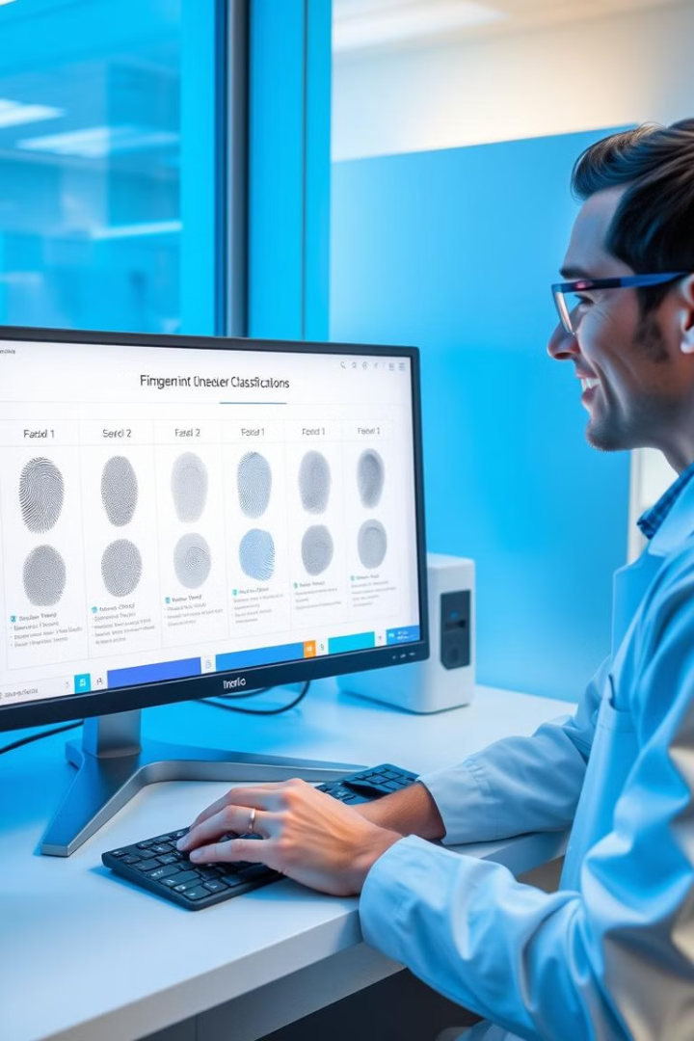
Aim & Objectives
Aim
To develop a non-invasive and automated blood group detection system using fingerprint images and deep learning.
Objectives
To collect and preprocess fingerprint images labeled with blood groups.
To implement and compare deep learning models (LeNet5, AlexNet, VGG16, and ResNet34).
To evaluate the models based on accuracy, precision, and recall.
To identify key fingerprint features correlated with blood groups.
Notes:
2

Slide 5
Literature Review
Paper Title
Authors & Year
Methodology Used
Pros
Cons
Blood Group Determination Using Fingerprint
T. Nihar et al., 2024
CNN (LeNet, AlexNet)
Non-invasive, Uses image processing
No accuracy mentioned, Needs larger dataset
A Novel Approach to Predict Blood Group Using Fingerprint Map Reading
P. N. Vijaykumar & D. R. Ingle, 2021
Ridge frequency estimation, Gabor filters, OLS regression
Uses feature extraction
Accuracy only 62%, Requires better ML model
Fingerprint-Based Blood Group Prediction Using Deep Learning
Swathi P et al., 2024
CNN model with fingerprint patterns
Improved accuracy over feature extraction
Limited dataset size
Notes:
3

Slide 6
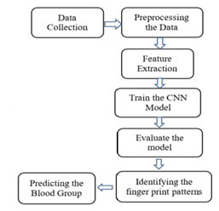
Methodology
Existing Methods
Serological Testing: Requires blood sample mixing with antibodies.
Automated Blood Typing Systems: Optical sensors analyze blood reactions.
Genotyping: Uses molecular techniques for antigen detection (costly & complex).
Proposed Method
Preprocessing includes image normalization, noise reduction, contrast adjustment.
Uses fingerprint images for blood group prediction.
Applies Convolutional Neural Networks (CNNs) to detect blood group patterns.
Feature extraction: Identifies ridges, bifurcations, and minutiae points.
Uses datasets of 6000 fingerprint images, labeled with blood groups.
Models are trained and validated using LeNet5, AlexNet, VGG16, and ResNet34.
Notes:
4

Slide 7
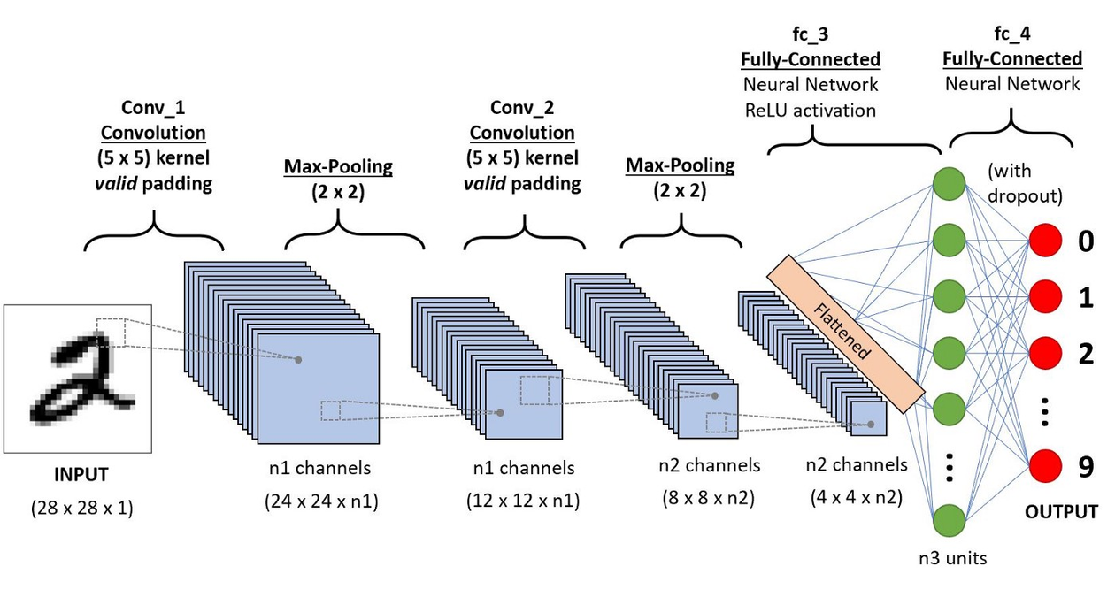
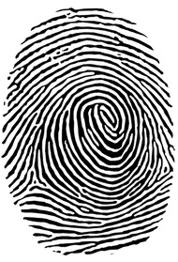
Proposed Framework
Step 1: Data Collection
6000 labeled fingerprint images
Step 2: Preprocessing
Grayscale conversion, Normalization, Denoising
Step 3: Feature Extraction
Minutiae points, Ridge endings, Bifurcations
Step 4: Model Selection
Comparing CNN architectures
Step 5: Training & Evaluation
Accuracy, Precision, Recall metrics
Step 6: Blood Group Prediction
Deploy best-performing model
Notes:
5

Slide 8
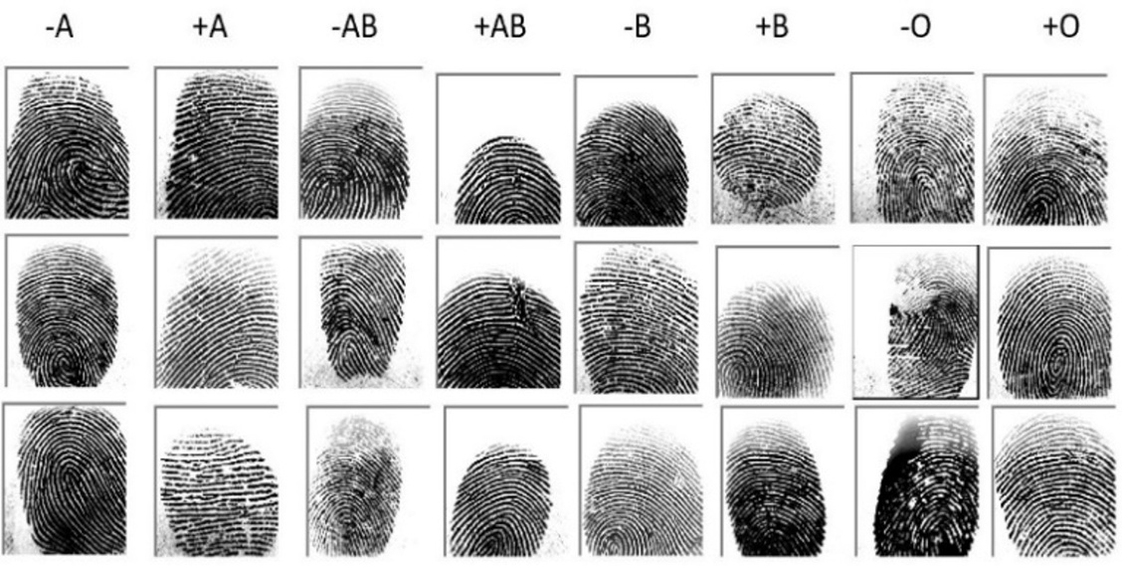
Dataset Collection
1
Dataset
Sources: Collected from students, peers, Kaggle fingerprint datasets.
Size: 6000 fingerprint images labeled with A, B, AB, and O blood groups (positive & negative).
Diversity: Ensured varied fingerprint patterns across different individuals.
2
Challenges
Fingerprint clarity varies due to moisture, cuts, or worn-out ridges.
Need for high-resolution images for precise classification.
Notes:
6

Slide 9
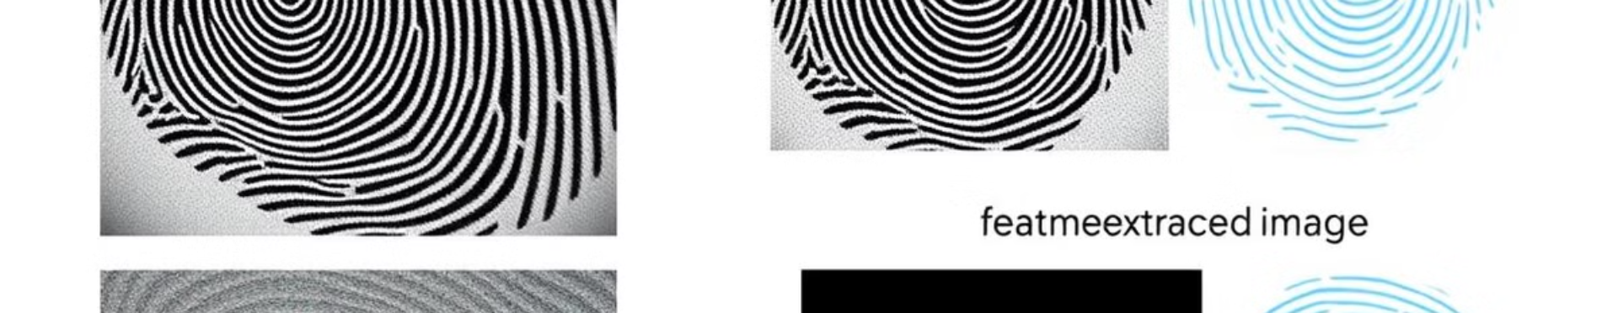




Feature Extraction
Grayscale Conversion
Normalization
Noise Reduction
Contrast Adjustment
Convert to grayscale to simplify processing.
Normalization to maintain consistency in pixel values.
Noise reduction (Gaussian filter) for clearer images.
Contrast adjustment to highlight fingerprint ridges.
Feature Extraction: Identifies bifurcations, ridge endings, and minutiae points. Extracted features fed into deep learning models for classification.
Notes:
7

Slide 10
MLP Classifier (Deep Learning Models Used)
LeNet5
A simple CNN with fewer layers, initially designed for digit recognition. Struggles with complex fingerprint patterns due to limited depth. Overfits easily and lacks generalization for real-world fingerprint variations.
AlexNet
Introduced deeper architecture with more convolutional layers. Performs better than LeNet5 but lacks fine-grained feature extraction. Poor accuracy in fingerprint recognition due to high computational demand.
VGG16
Uses deep layers (16 layers) to capture intricate fingerprint details. Performs well but prone to overfitting due to high parameter count.Computationally expensive requiring significant training time and resources.
ResNet34
Introduces residual connections to prevent vanishing gradients. Achieves the best accuracy by effectively learning fingerprint features. Generalizes well, making it ideal for fingerprint-based blood group detection.
Notes:
8

Slide 11
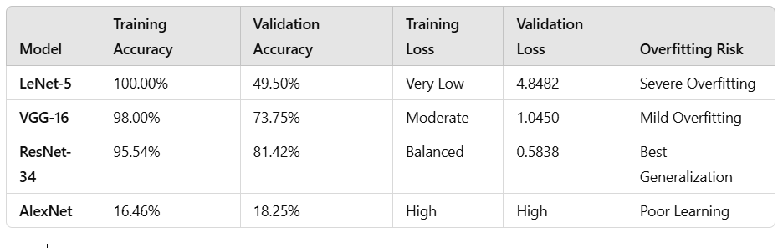
Results and Discussion
Model Performance:
ResNet-34 achieved the highest validation accuracy (81.42%) with balanced training, showing the best generalization.
VGG-16 performed well (73.75%) but had mild overfitting.
LeNet-5 showed severe overfitting with 100% training accuracy but only 49.50% validation accuracy.
AlexNet had the lowest performance due to poor learning (18.25% validation accuracy).
Key Observations:
Deep networks with residual connections (ResNet-34) prevent vanishing gradients and improve accuracy.
Overfitting risk increases with model complexity if regularization is not applied.
Proper dataset preprocessing and feature extraction enhance classification performance.
Notes:
9

Slide 12
Conclusion and Future Work
Conclusion
Future Work
Our study demonstrated that fingerprint images can be used for non-invasive blood group detection using deep learning.
Expand the dataset with more diverse fingerprint images.
Improve model accuracy using transformer-based deep learning architectures.
ResNet34 performed best with 81.42% validation accuracy, making it a promising model for real-world applications.
Implement real-time fingerprint scanning and cloud-based deployment for rapid blood group detection.
The approach has potential applications in healthcare, forensic science, and biometric security systems.
Conduct clinical trials to validate effectiveness in real-world scenarios.
Notes:
10

Slide 13
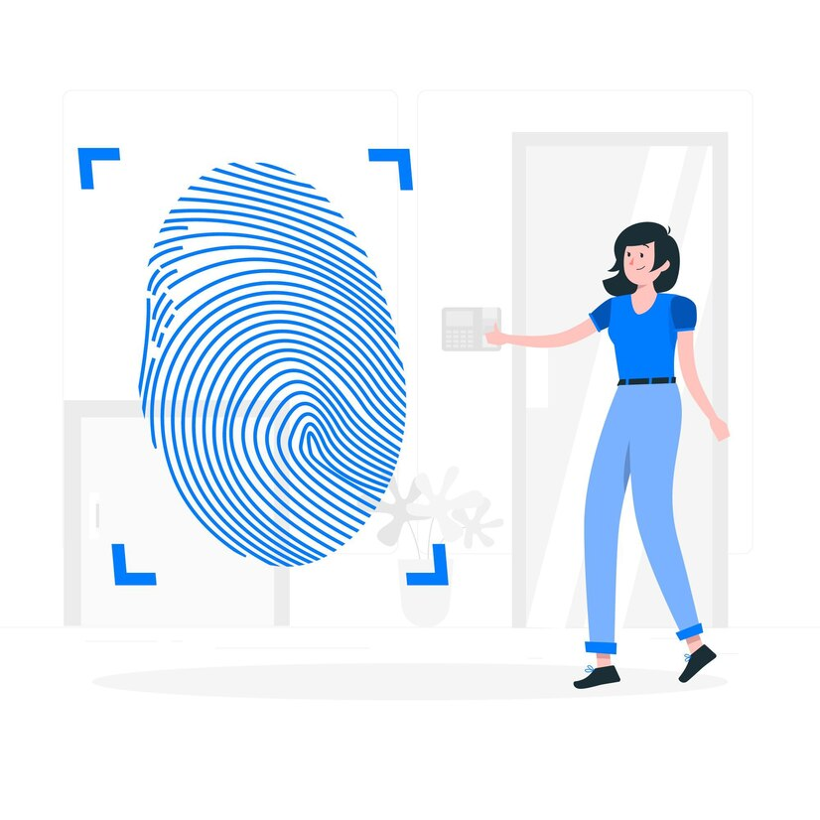
Thank You!
Notes:
10

